Slide 1
AIDI - 1100 - 02
INTRODUCTION TO AI DEVELOPMENT
Jugnu Shefin (100814025)
Esra Ersoy (100)
Abhishek Joshi (100820424)
Dheeraj Savanthy (100846124)
Akash Patel (100838052)
FINAL PROJECT
GROUP #3

Slide 2
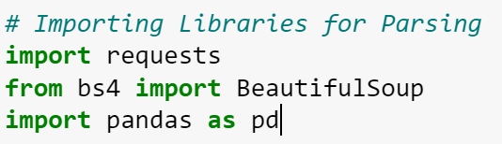
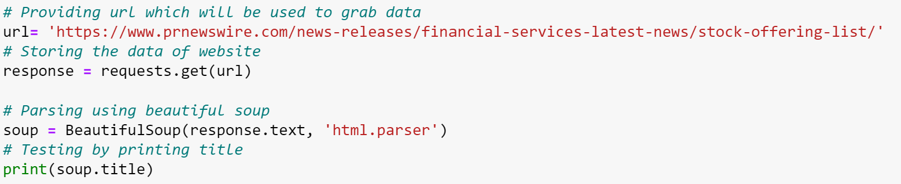
Scan/Parse
Scanning and Parsing of Data are conducted
with the use of Beautiful Soup Library.
The Data fetched from the URL is stored
in a variable called Soup.

Slide 3
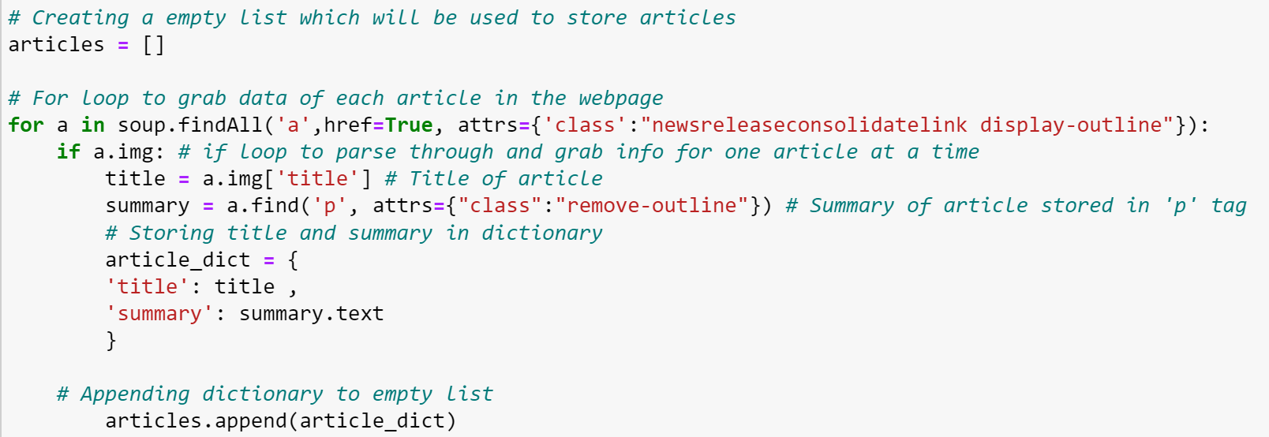
Track/Store/Search
TRACK
The Data is Tracked using html attributes. Mainly image title and paragraph.
To Track the data find() function is been used.

Slide 4
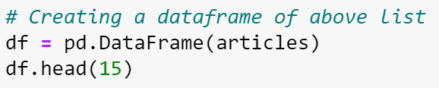
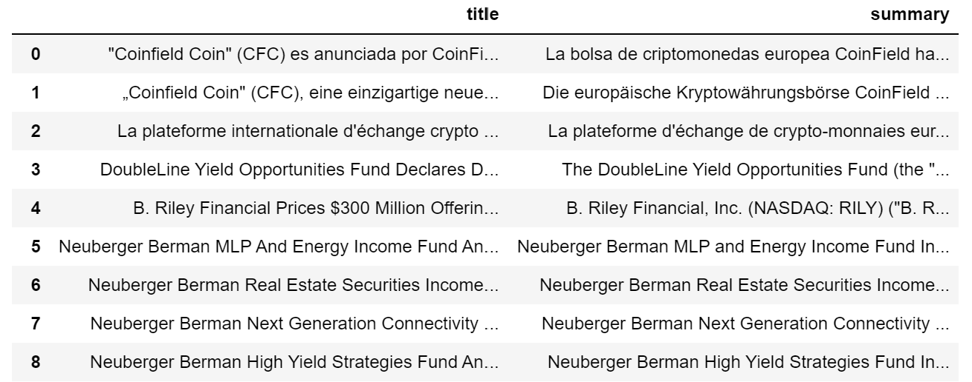
Store
Track/Store/Search
The Data fetched from the URL saved in List
named Articles is now Converted into a
Dataframe for more convenience

Slide 5
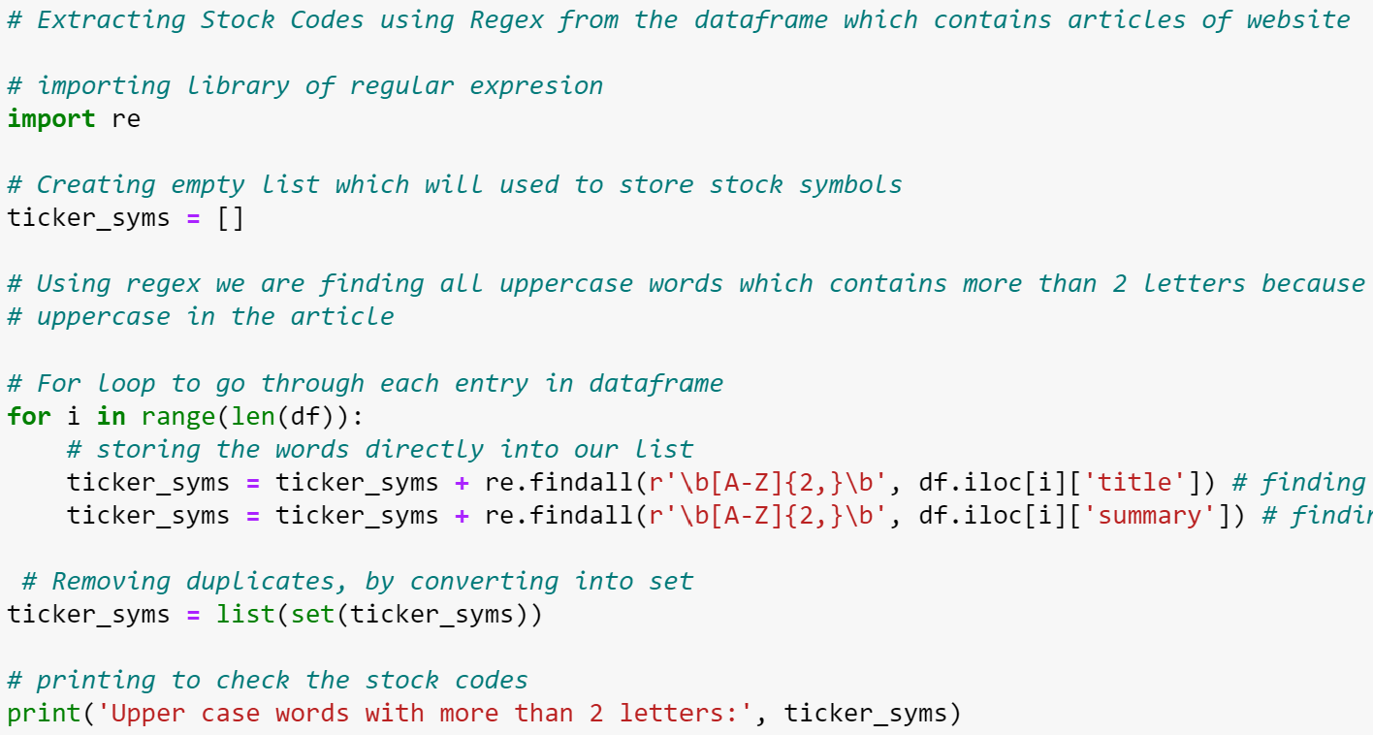
SEARCH
Track/Store/Search
Different Stock Symbols are Searched into the File using Regular Expression.
The findall() function is used to locate different
tickers
The Symbols are then stored in a list

Slide 6
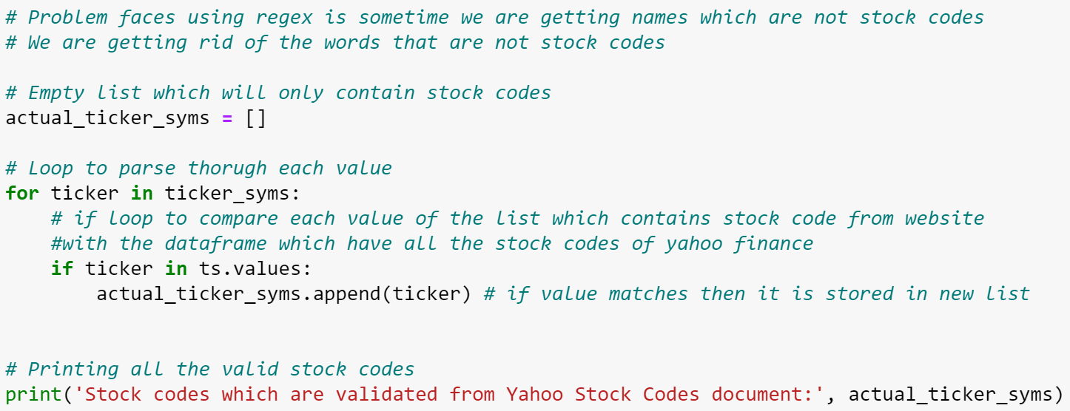
CONTINUE
While using REGEX to Locate Ticker Symbols we ran into a problem of getting different
Junk symbols which weren’t Stock Symbols.
So, to Eliminate those we Compare the Symbols with real Symbols fetched
from a reliable Source.(YAHOO Finance)

Slide 7

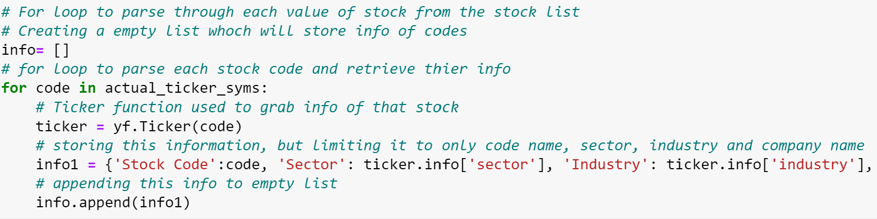
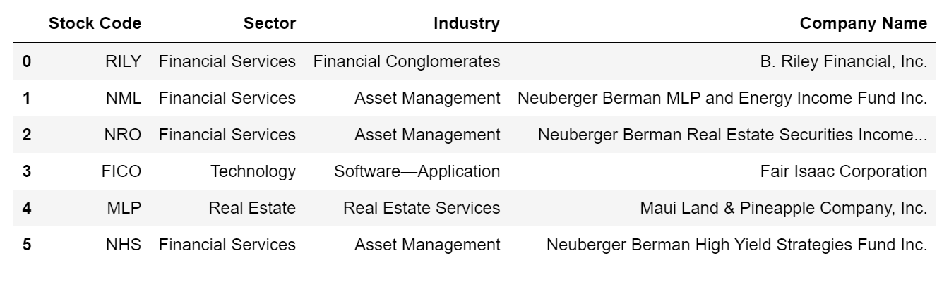
Retrieve stock price
Yahoo yfinance library is been used to
retrieve stock Data.

Slide 8
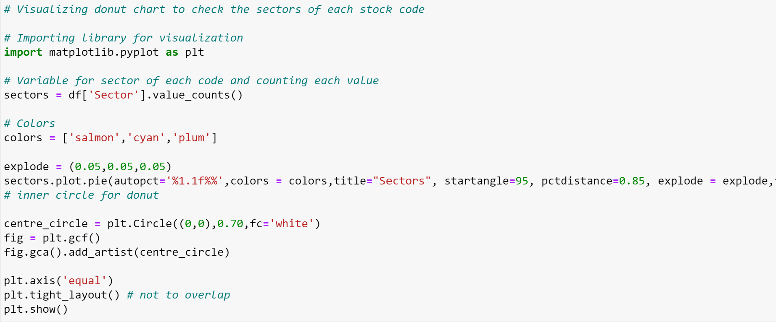
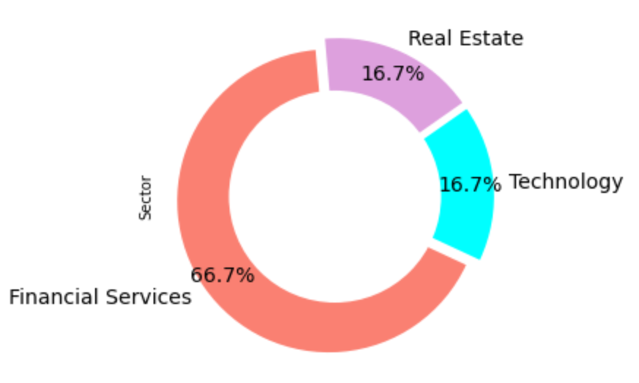
Visualizations
Here, The Donut Chart Shows what percentage of stocks
belongs to what Sector respectively.

Slide 9
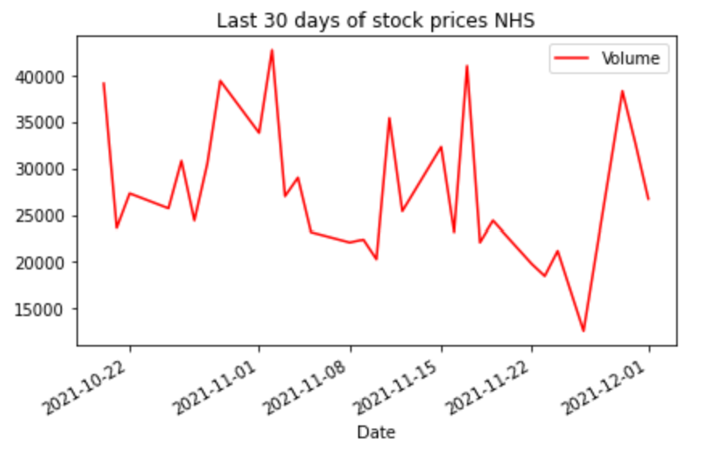
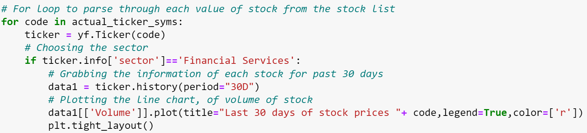
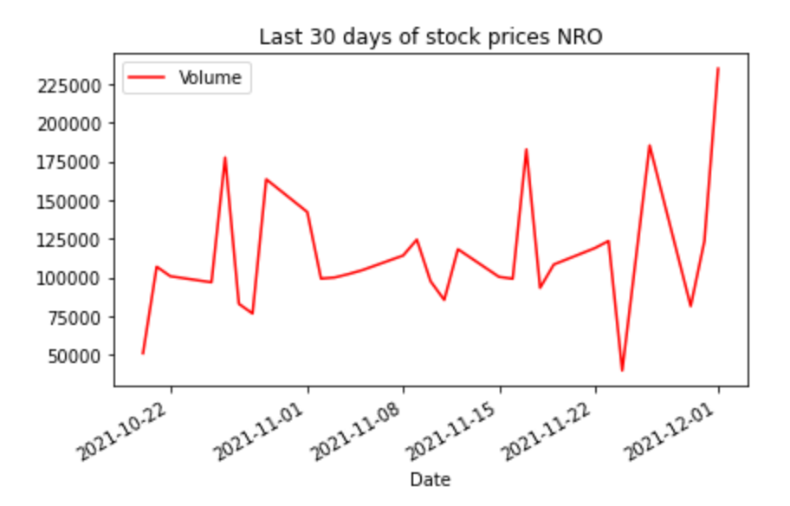
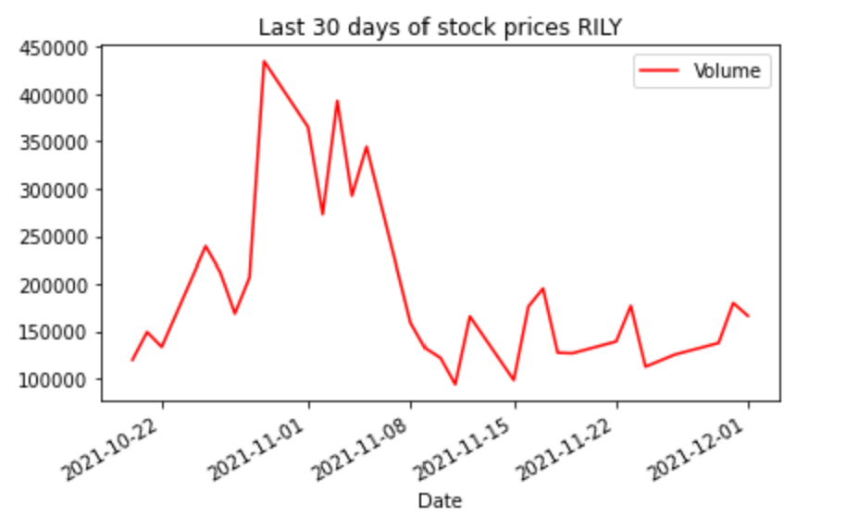
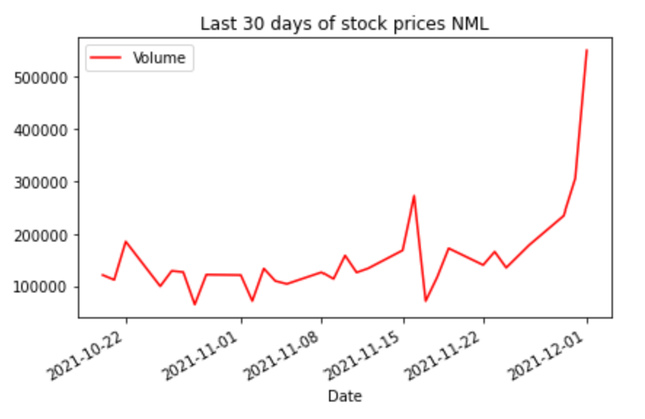
Visualizations
Here, The Using a for loop the graph for history of 30days of the stock list is shown.

Slide 10
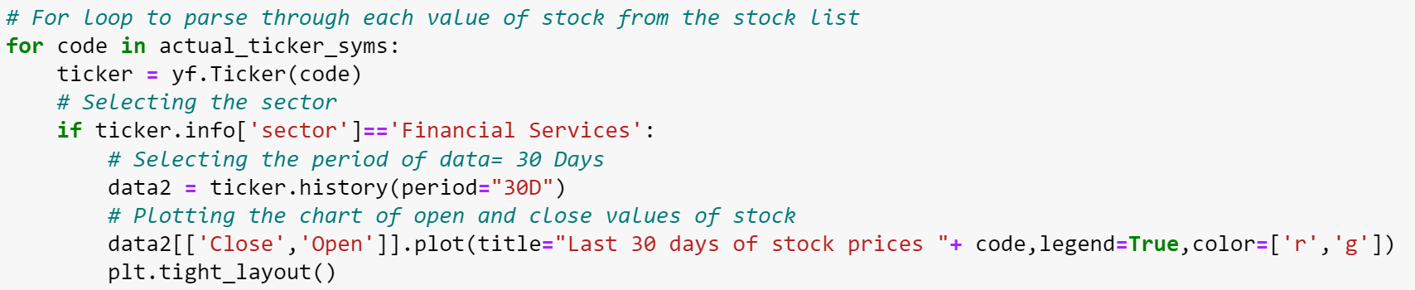
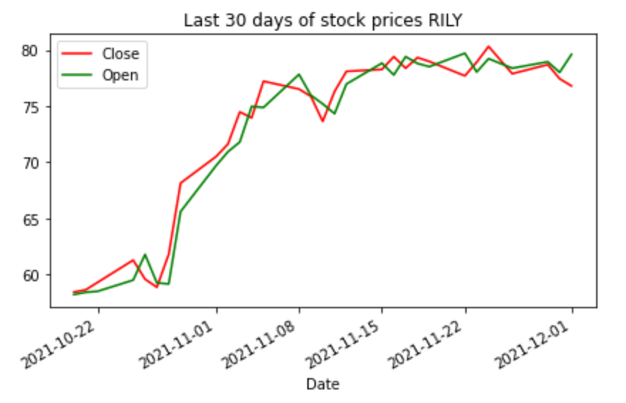
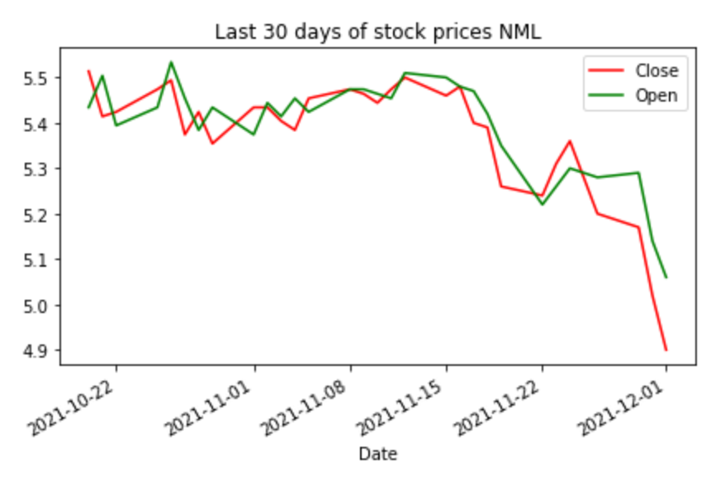
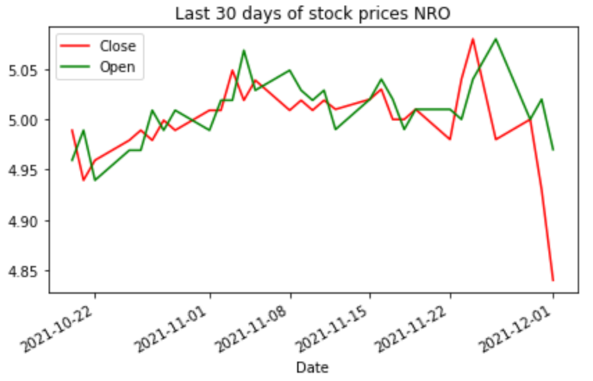
Visualizations
Here, Using a graph open and close history of stock for the last 30 days is shown.

Slide 11
Conclusion

